Slide 1
IDS 312:
Business Project Management
Work Breakdown Structures (WBS)
Spring Semester 2022 – 01/24/2022

Slide 2
Defining the Work
After understanding what needs to be accomplished during the project, the next step is defining what specific work needs to be accomplished as well as how the work will be accomplished (and planning accordingly)!
This leads to the development of the Work Breakdown Structure (WBS)

Slide 3

The Work Breakdown Structure
Create Work Breakdown Structure (WBS) is the process of subdividing project deliverables and work into smaller, more manageable components
The Work Breakdown Structure (WBS) is an essential element of the overall scope and project planning process…as well as managing the project
Classic definition: The WBS is a deliverable-oriented hierarchical decomposition of the work to be executed by the project team to accomplish the project objectives and create the required deliverables, with each descending level of the WBS representing an increasingly detailed definition of the project work
The WBS is not only a critical document in terms of overall scope and project planning; it also plays a critical role in the development of the project schedule and the project budget, as well as other aspects of the project

Slide 4
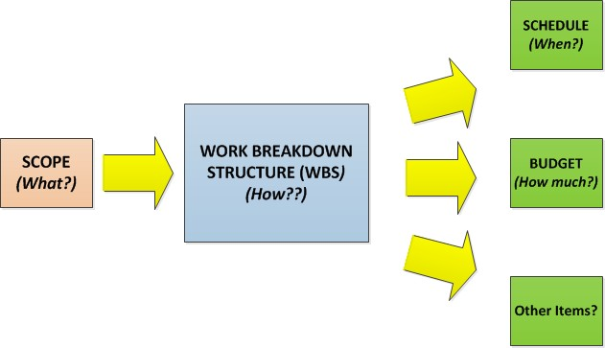
The Work Breakdown Structure: The How of Project Planning
It’s not an exaggeration to consider the development of the Work Breakdown Structure (WBS) to be the how of the project planning process…and beyond!

Slide 5
Why the WBS?
The WBS helps to concentrate the focus (first and foremost) upon the deliverable or deliverables being produced as part of the project
This process then leads to a determination of the type of work
needed to create those deliverables
Through the process of developing the WBS, the scope of the project can be further refined and detailed
The WBS also provides a handy “checklist” of the work that
needs to be accomplished as part of the project

Slide 6
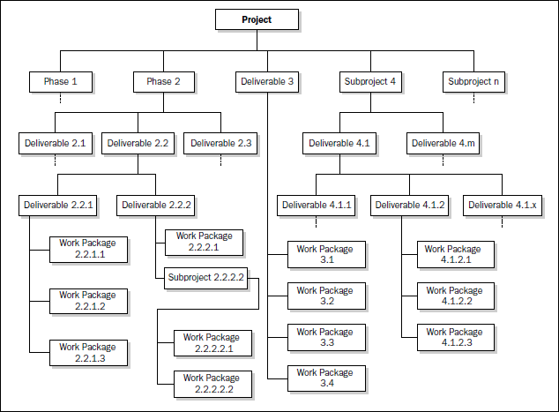

Slide 7
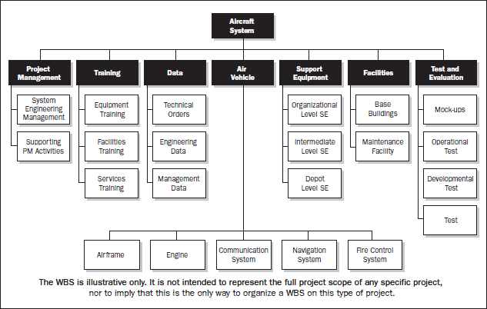

Slide 8
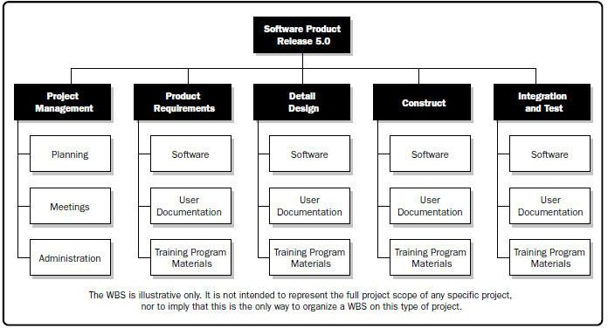

Slide 9
How is the WBS Used?
First and foremost, the WBS is meant to help further define the project scope to the point where all deliverables are clearly defined and are unambiguous
The WBS is also the foundation for defining the project tasks and
activities, and, ultimately, for scheduling the work
The WBS also factors into cost estimation by allowing for more manageable estimates to be developed based upon specific work products (and the associated levels of effort)
Also, the WBS be the basis for inspection checklists and acceptance criteria
(again, by providing details related to the specific deliverables)
The WBS can be an important monitoring and control tool by providing discrete, measurable elements
As changes occur, the WBS may need to be modified accordingly

Slide 10
The 100% Rule
The 100% Rule states that the WBS includes 100% of the work defined by the project scope and captures ALL of the deliverables – internal, external, and interim – in terms of work to be completed, including project management
“The sum of the work at the “child” level must equal 100% of the work represented by the “parent” and the WBS should not include any work that falls outside the actual scope of the project (it cannot include more than 100% of the work)
The 100% Rule is a critical “guiding factor” in terms of developing the WBS; again, it aims to keep the project focused, and to keep the attention of everyone focused upon the actual work at hand

Slide 11
Decomposition
Decomposition is the process of breaking down the project scope and deliverables into smaller and more manageable pieces until you get to the lowest level of detail
Each component “block” of the WBS is sometimes referred to as a WBS
element
The work package is a deliverable or project component at the lowest level of a “branch” of the WBS (you cannot subdivide the deliverable any further at this point)
As a result, the work package should be a discrete, measureable, and well-
defined deliverable
A work package can be scheduled, cost estimated, monitored, and controlled
These two above items should be used as the “litmus test” to determine if you have arrived at the lowest level possible

Slide 12
Deliverables vs. Tasks
By its very nature (and definition), the WBS is meant to be focused upon deliverables (the “what” of the project)
Deliverables allow for the total scope of the project to be better defined
As a result, nouns and adjectives are used while constructing the components of the WBS
A task-oriented WBS is built using verb-noun structures, and focused upon tasks and processes
Be advised: Focusing upon the tasks and processes can lead
to problems because:
Attention is diverted away from the deliverables (the “reasons” that the project exists)
It can be difficult to determine if all work products have been
completed

Slide 13
Reality Check: Deliverables AND Tasks
The classic, PMI-based WBS is solely focused upon deliverables
In reality, WBS’ are often created with both deliverables
and activities/tasks in mind
Breaking out the activities is actually a part of schedule development
In the interests of time (and in my opinion), it is perfectly acceptable to start breaking out, identifying, and listing activities at the same time that you break out deliverables!

Slide 14
Four Steps in Creating the WBS*
Specify the project objectives
Identify specifically the products, services, or results (deliverables or end items)
Identify other work areas to make sure that 100 percent of the work is identified
Subdivide the elements until a level is achieved that is suitable for planning and control
– Note: use the SMART rule!
Haugan, Gregory. "Effective Work Breakdown Structures," 1st Edition.

Slide 15
Constructing the WBS
The methods and levels of decomposition ultimately depend upon the type and nature of the specific project, and other factors such as the project manager involved, any specific organizational methodologies, etc.
The main guiding force will be the scope – remember, if it doesn’t fall within
the scope of the project, it doesn’t belong here
The number of branches and levels will depend upon the project
There must be a minimum of two levels
The “classic” (and easiest to develop) WBS is the “top-down” structure which closely resembles an organizational chart
The uppermost level (one element) will be the project name (ideally
featuring the primary deliverable to be produced, if possible)

Slide 16
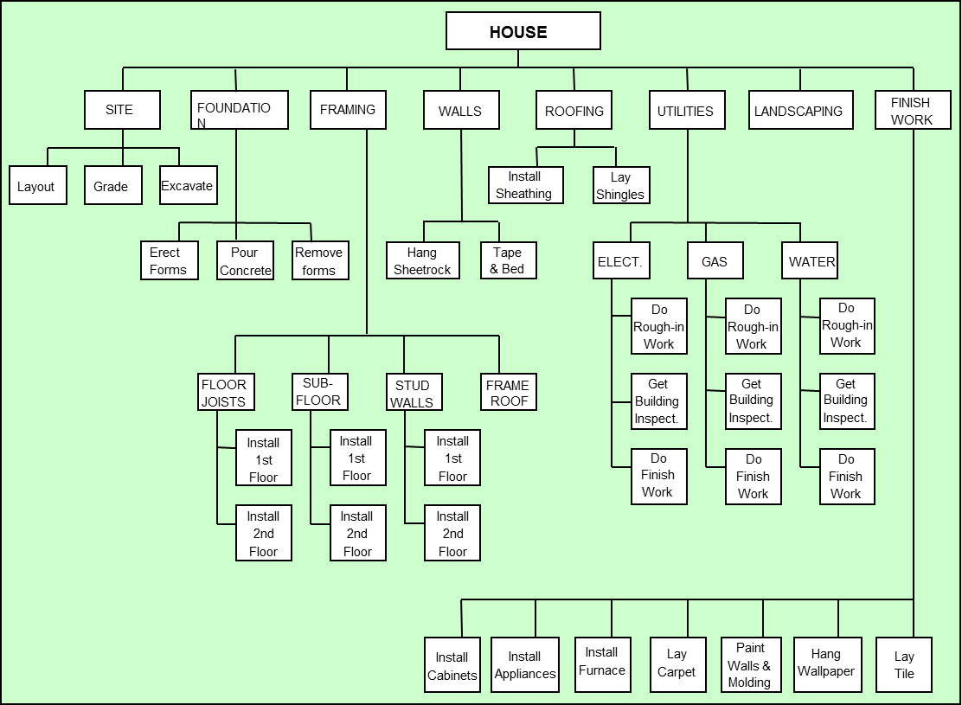

Slide 17

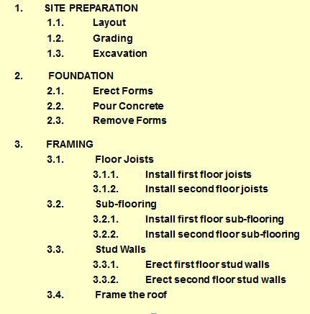

Slide 18
WBS Construction “Rules of Thumb”
Level 1 (and there will always be a Level 1) generally equates to either the final deliverable being produced as a result of your project and/or the name of your project
The former tends to be the more accurate “rule of thumb” but this can be done both ways
It really depends upon your project!
Level 2 of the WBS is where things will get trickier
At this point, you have more “creative freedom”
Much will depend upon templates that may exist in your organization, if any
Much will also depend upon the nature and type of project itself
In some WBS scenarios, the Level 2 elements equate to project phases (if you are following a particular Project Life Cycle methodology

Slide 19
Level 3..and Beyond
At Level 3, you will get even more specific
These are essentially the deliverables needed to produce the deliverables one level higher
You may not even have a Level 3 (or may not have them for all
branches)
Remember that when you get to the point that you cannot break down the deliverables any further, then you have your work packages
Once you have arrived at your work packages, your WBS (at least
this first version of it) is complete
You are now at the point where you can break down the work packages into the activities and tasks needed to produce them…which leads to the development of the Activity List

Slide 20
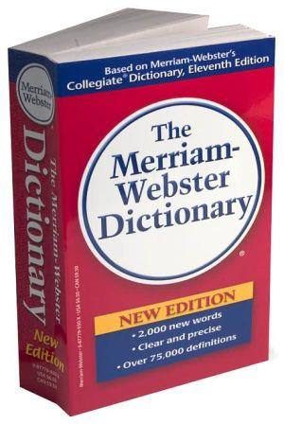
The WBS Dictionary
The WBS Dictionary accompanies the actual WBS and provides more detailed descriptions regarding the WBS elements
Details may include cost estimates and any
specific control accounts, if applicable
Also, the ultimate work packages that will result from further decomposition of the element will be listed
A further list of possible items in the WBS Dictionary is outlined in the PMBOK
Each element in the WBS will have a corresponding entry in the WBS Dictionary

Slide 21
Tools for Developing the WBS
There are many tools available for developing the WBS
Software
Specific WBS-development Software
Mindjet MindManager
MS Visio
MS PowerPoint
MS Word
Good, old-fashioned pen and paper (not the most aesthetically
pleasing or professional looking)
Post-It notes!

Slide 22
Tips for Developing the WBS
Develop and use a consistent numbering scheme!
Development of the WBS involves a team approach
Subject Matter Experts are again critical, as are institutional knowledge and organizational assets, best practices, etc.
Primary documents (inputs) include the Project Scope Statement
and a listing of all requirements
Any other documentation is helpful
Templates are very handy for helping to develop a WBS
Many can be found online or purchased
Brainstorming sessions are very effective in terms of developing the WBS
Agree upon the development approach/method first!

Slide 23
Schedule
Finalize Teams 1/24/22
Draft Charter Scope Due Sat 1/29/22

Slide 24
1 Abubaker Amodi aamodi4@uic.edu
1 Evette Tamayo
1 Ali Alaziz
1 Basheer Anaam
1 Gonzalo Del Villar
2 Morgan McKernin
2 Brooke Bellair
2 Rida Farhat
2 Simrah Shaik
2 Rey Fowler
2 Laura Juzenas ljuzen2@uic.edu
3 Nia Donald
3 Patrick Asztabski
3 Yelizaveta Semikina
3 Aleksandr Khvorostenko
4 Le Huu Bang Trinh ltrinh7@uic.edu
4 Giselle Flores gflor3@uic.edu
4 Maria Morales, mmoral62@uic.edu
4 Mutasim Chowdhury mchowd7@uic.edu
4 Isabel Torres itorr3@uic.edu
4 Nina Dorado ndorad2@uic.edu
5 Bella Patel
5 Pres Harris
5 Dimitar Stefanov
5 Samir Al Ali salali5@uic.edu
5 Alheyo Tacmo

Slide 25
6 Tabassum Yousuf tyousu2@uic.edu
6 Ashley Xiong axiong6@uic.edu
6 Adam Beigel abeige2@uic.edu
6 Vukovic Stefan
6 Mohamed Moustafa
6 Watson Mark
7 Patel Shivani spate513@uic.edu
7 Perez Eljasz eperez70@uic.edu
7 Reina Nicolas
7 John Akshay ajohn226@uic.edu
7 Roberts Cortland
7 Hermanny De Figueiredo Marina
8 Ayala Javier jayala24@uic.edu
8 Martinez-Ayala Alejandro amart254@uic.edu
8 Hussain Amaan ahussa52@uic.edu
8 Hussaini Yousuf yhussa4@uic.edu
8 Haque Irane ihaqu3@uic.edu
8 Fu Wensong
8 Fink Lucas
9 Alhasanat Alaa aalha20@uic.edu
9 Bisceglie Nick nbisce2@uic.edu
9 Brosnan Sean sbrosn3@uic.edu
9 Chacon Steven chacon1@uic.edu
9 Russell Joe jrusse27@uic.edu
10 Zubairy Salman mzubai2@uic.edu
10 Khan Ather akhan294@uic.edu
10 Karla Rubio krubio3@uic.edu
10 Moustafa Mohamed mmoham60@uic.edu

